Slide 1
Lecture No. 35 Instrumental Methods of Analysis
At the end of this lecture, students will be able to:
State Beer-Lambert’s law and its application in colorimetry
Explain the observed spectra of colored solutions with reference to standard spectrophotometric chart
Determine the concentration of an unknown colored solution using colorimetric data

Slide 2
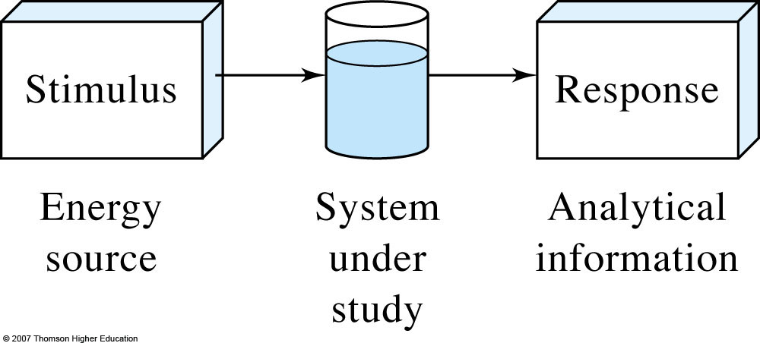
Block diagram of an instrumental measurement
Instrumental Methods of Analysis
Classical Methods: Wet chemical methods such as precipitation, extraction, distillation, boiling or melting points, gravimetric and titrimetric measurements
Instrumental Methods: Analytical measurements (conductivity, electrode potential, light absorption or emission, mass-to-charge ratio, fluorescence etc.) are made using instrumentation

Slide 3
Instrumental Methods of Analysis
Chemical analysis involves identifying and determining the percentage composition of sample
Qualitative determining what species are present?
Quantitative determining how much of a species is present?
Sample under analysis is called analyte
Methods for quantitative are titrimetry (volumetry), gravimetry and instrumental methods

Slide 4
Instrumental Methods of Analysis
Estimation of quantity of substance either by volumetry or gravimetry will not give accurate result
Volumetry: its not easy to get exact end point
Gravimetry: not easy to convert all ions or substance into precipitate
Instrumental: using a instruments to find quantity

Slide 5
Instrumental Methods of Analysis
Principle:
An analytical instrument converts a property of a substance under investigation into an electric signal that can be measured by a suitable device
Absorption of light
Emission of light
Changes in the concentration during redox and neutralization
Example : Colorimetry, potentiometry, conductometry

Slide 6
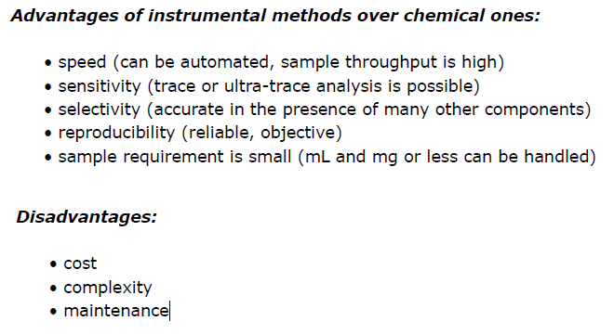
Instrumental Methods of Analysis

Slide 7
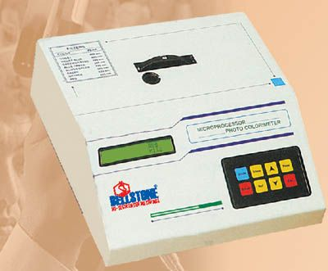
Colorimeter
Most common analytical technique used in biochemical estimation in clinical laboratory
Involves the quantitative estimation
Substance to be estimated should be colored or it should be capable of forming colored complex by the addition of reagents
Colored substance absorb light in relation to their color intensity
Color intensity will be proportional to the conc. of colored substance

Slide 8
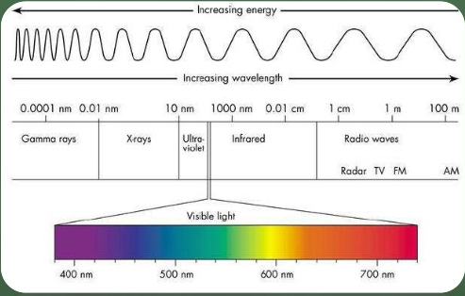
Electromagnetic spectrum
Notes:
http://www.slideshare.net/biochem/colorimeter-ppt-biochemistry

Slide 9
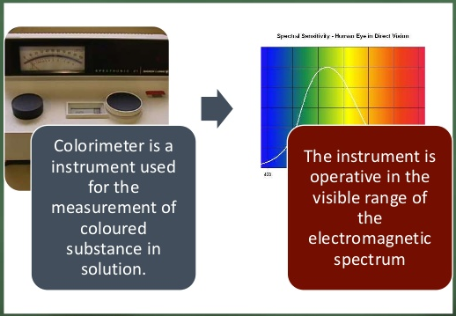
Colorimeter

Slide 10
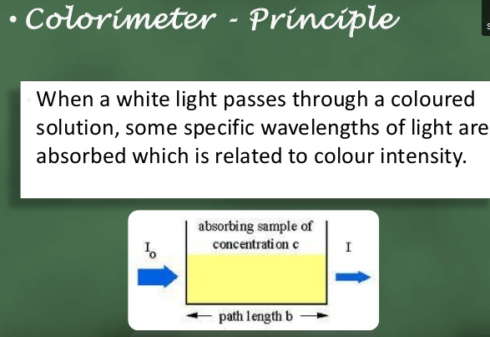

Slide 11
Colorimeter
Colored solutions have the property of absorbing certain wave length of light when a monochromatic light is passed through them
Amount of light absorbed or transmitted by a colored solution is in accordance with two laws: Beer’s law and Lambert’s law
Lambert’s law
Amount of light transmitted decreases exponentially with increase in path length (diameter) of the cuvette or thickness of colored solution through which light passes.
Beer’s law
When a monochromatic light passes through a colored solution, amount of light transmitted decreases exponentially with increase with increase in concentration of the solution

Slide 12
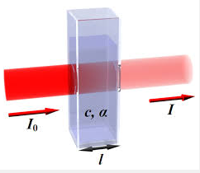
Colorimeter
Beer-Lambert’s law
Amount of light transmitted through a colored solution decreases exponentially with increase in Conc of the colored and increase in path length of cuvette or thickness of the colored solution A = ЄCt Where ‘A’ is absorbance, ‘C’ is concentration, ‘t’ is thickness and ‘Є’ is a constant called molar extinction coefficient.
Є is constant for a given substance (it’s the absorbance of 1 mole solution of 1cm thickness)
Absorbance A of a medium is defined
A = -log₁₀T = log₁₀P₀/P
t
P₀
P
Absorbing solution of concentration,C

Slide 13
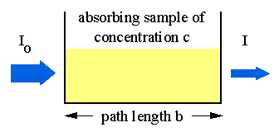
Transmittance is Related to Absorbance
Transmittance is given by the equation:
T = I/I_{o}
where I is the intensity of the light after it has gone
through the sample & I_{o} is the initial light intensity.
Absorbance is related to the %T:
A = -logT = -log(I/ I_{o})

Slide 14
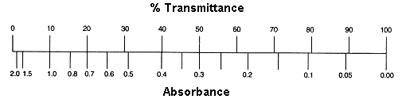
Equation Summary
T= (I/I_{o}) = 10^{-A} %T = (I/I_{o}) x 100 A = -logT = log(1/T)
Sample Calculation
If %T = 95%, then A = log(100/95) = log(1/.95) = log(1.0526)
A = 0.02227
Note the scale for Absorbance: 9/10th of the scale is from 0-1 and 1/10th is from 1-2.
For this reason, the spectrometers have been calibrated in % Transmittance and
all readings will be taken in %Transmittance.

Slide 15
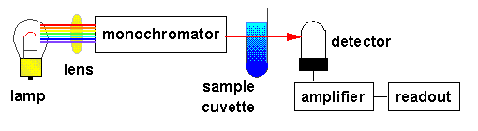
Construction
Lamp emits all colors of light (i.e., white light).
Monochromator selects one wavelength and that wavelength is sent through the sample.
Detector detects the wavelength of light that has passed through the sample.
Amplifier increases the signal so that it is easier to read against the background noise.

Slide 16
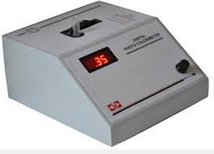
Working of colorimeter
Light from a light source passes through a Cuvette containing a solution sample
Some of the incoming light is absorbed by the solution
As a result, light of a lower intensity strikes a photodiode

Slide 17
Colorimetric estimation of copper
Colorimetric estimation of copper in given unknown solution
Principle:
The absorbance of light of a particular wavelength by a substance in solution varies directly with its concentration and the thickness of the solution
When the thickness of the medium is kept constant, the absorbance directly depends upon the concentration
Experimental procedure :
Pipette out 2,4,6,8 and 10 cm³ of given copper sulphate solution into separate volumetric flasks
Add 2.5 cm³ of ammonia to each of them and also into the test solution of unknown concentration(ml)
Make it up to the mark (25 cm³ )and mix well

Slide 18
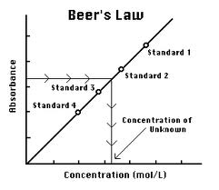
Colorimetric estimation of copper
Measure the absorbance of each of these against blank solution (Only ammonia and water)
Plot a graph of absorbance (OD) against volume I concentration of cupric ions and determine the concentration of copper in the test solution
Reaction
Cu²⁺ (aq) + 4NH₃ (aq) → [Cu(NH₃)₄] ²⁺ (aq)
^{Light blue Dark blue}

Slide 19

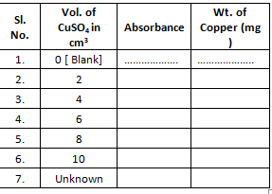
TABULATION AND CALCULATIONS:
Weight of copper sulphate pentahydrate present in 100 cm³ of the given solution = ‘X’ mg
Weight of CuSO₄ .5H₂O in 1 cm³ of its solution = X/100 mg =…………………… = ‘Y’ mg
Weight of copper present in 1 cm³ of its solution
REPORT:
Volume of unknown solution = …. cm³
Amount of copper in the given unknown solution = ………… mg

Slide 20
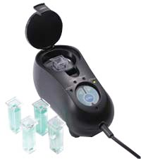
Colorimeter
Limitation of beers lamberts law
Applicable only for monochromatic light
Only dilute solution

Slide 21
Maintenance
Calibration
Adjustment
Replacement of burned-out lamp and photo detector
Electronic problems are rare

Slide 22

Summary
Beer-Lambert’s law
Amount of light transmitted through a colored solution decreases exponentially with increase in Conc of the colored and increase in path length of cuvette or thickness of the colored solution
A=ЄCt Determination of concentration of an unknown colored solution using colorimetric data

